Slide 1

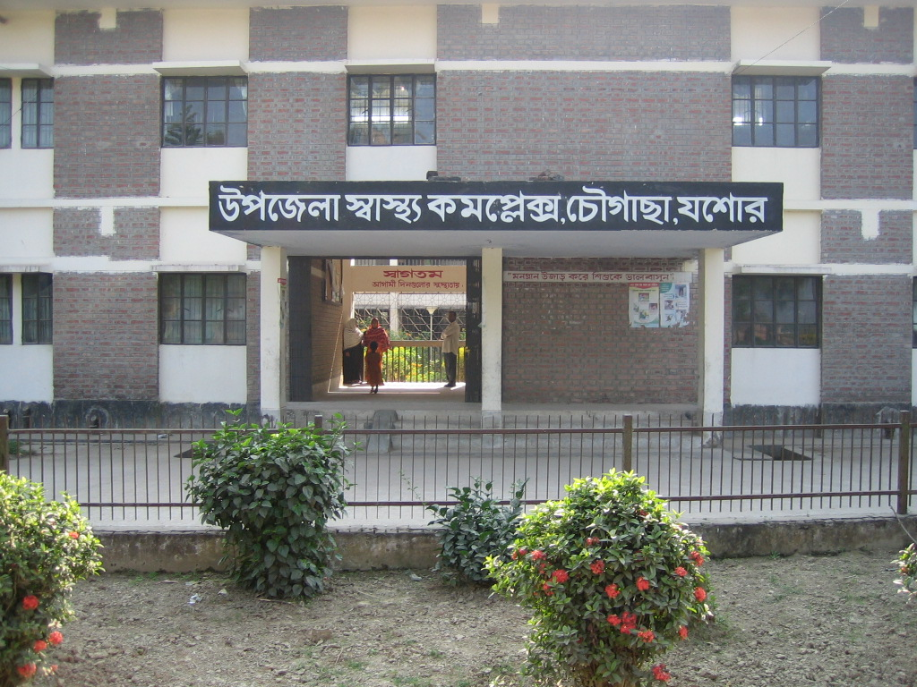
50 BEDED UPAZILA HEALTH COMPLEX
Chowgacha, Jessore.
Dr. Md. Emdadul Haque
Junior Consultant (Obst & Gynae)

Slide 2
A District level Patient-Friendly Hospital with a Vision …
Maximum utilization of Govt.
resources with
honesty and sincerity
Integrated approach of
Administration, Community
Leaders & Health
Management
Providing Effective and
prompt services
through improved
management system
Show respect to the
patients

Slide 3
Health Profile of Chowgacha Upazila- 2011
Total population : 247887
Total Fertile Couples : 53033
Total Pregnant : 5264
Total Delivery : 4475
Total Live birth : 4389
Total death : 1009
Health Man power
a. Doctor : 12 (10+2)
b. Nurse : 18(14+4)
c. HA : 25
d. SBA : 13( 3HA+10 FWA )
e. Volunteer, Security guard & cleaner: 52
8. Health Institutions
a. Health Complex : 01
b. H & FWC : 11 (RD- 4 + FWC– 7 )
c. Community clinic : 23
d. Non- Govt. Clinic : 04

Slide 4
9. Mother Taken-ANC 1st : 170% (8935)
10. Chowgacha Mother ANC 1st : 96% (5044)
11. Hospital Delivery Rate : 98.6% (4413)
12. Hospital Delivery rate of Chowgacha Mothers
(Chowgacha UHC) : 67% (2979)
13. Total C. Section rate : 22.5% (1007)
14. Total C. Section rate of
Chowgacha Mothers : 12.8% (575)
15. No. of Hospital bed : 50
16. Bed Occupancy Rate : 208%
17. CPR : 69%
18. CBR : 17.7 /1000 population
19. CDR : 4.1 /1000 population
20. Population Growth Rate : 1.36 %
21. Maternal Mortality Ratio : 68 / 100000 live birth
22. Neonatal Mortality Rate : 18.2 / 1000 live birth
23. Infant Mortality Rate : 23.6 /1000 live birth
24. Under-5 Mortality Rate : 25.7 /1000 live birth

Slide 5
Background History of MCH services of Chowgacha Health Complex, Jessore
To reduce Maternal and Child Mortality and Mobility and to ensure the quality services to the mother and child, UHFPO opened 4 special activities headed by medical officers in Feb. 1996. And from January 1995 to 1997 JICA helped us by Frontline MCH Program to implement the program by giving technical and logistic supports. Since 1998 DGHS & UNICEF have continued the support.
support.
<4 Special activities>
ANC-Corner – leaded by female Medical Officer for pregnant mother for effective ANC services who receive TT immunization in the Health Complex
Basic EOC service by a Gyne & Obs. trained MO
Under 5 corner for under 5 children for their nutritional assessment and treatment by RMO.
Monthly birth and death record by specially developed format by health assistant throughout the Upazilla to asses the progress of maternal and child health status by health indicators supervised by UH&FPO

Slide 6
Contd.
From Dec. 1999 Reproductive Health Department of DGHS and UNICEF gave logistic supports and human resources development (like medical officer trained in anesthesia).
Form November 2000 started Comprehensive EOC program.
In 2004, 2005, 2006, 2007 , 2008, 2009, 2010 & 2011 the UHC was awarded by the Bangladesh Government and UNICEF for best performance on EOC Service.
From August 2006 Safe Blood Transfusion unit established with the aid of UNICEF.
From April 2007 Demand Side Financing (DSF) program started.
Women friendly Hospital declared in 2008.
Hospital is declared as model health complex on 20 June 2008 and upgraded to 50 bedded hospital by Secretary of Ministry of Health & family welfare.
Chowgacha health complex Model is replicable through out the country. Declared by Dr. Margaret Chan, D.G. WHO on 8th March 2010.
Major Killer Disease (diabetes, hypertension, cancer, RTA & poisoning) prevention program starts in 1st January-2011.
TQM activates starts in July 2011 by the support of JACA.

Slide 7
Upazila Health Complex
CHOWGACHA , JESSORE.
Emergency & Out door Service 2005 to 2011
Sl No | Year | Emergency Patients | Out door Service
01 | 2005 | 4308 | 80591
02 | 2007 | 4287 | 105963
03 | 2008 | 4275 | 120117
04 | 2009 | 5144 | 126369
05 | 2010 | 7071 | 95958
06 | 2011 | 6318 | 91638

Slide 8
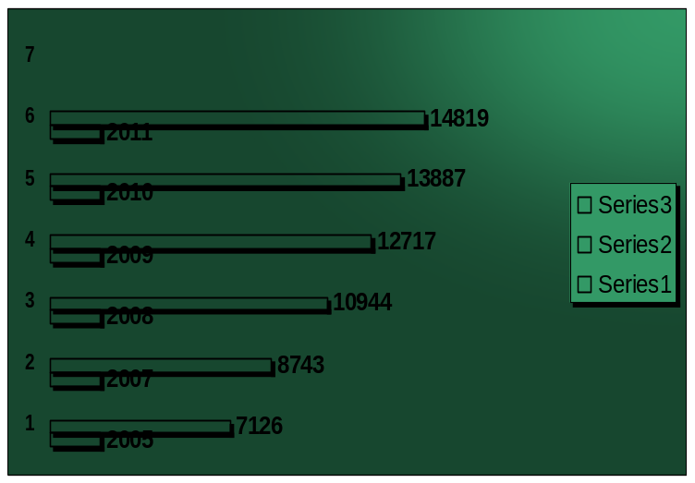
Upazila Health Complex
CHOWGACHA , JESSORE.
Indoor Service 2005 to 2011
Sl No | Year | indoor Service | No of Bed | Bed occupancy rate
01 | 2005 | 7126 | 31 | 158.0%
02 | 2007 | 8743 | 31 | 201.0%
03 | 2008 | 10944 | 50 | 199.0%
04 | 2009 | 12717 | 50 | 185.0%
05 | 2010 | 13887 | 50 | 200.0%
06 | 2011 | 14819 | 50 | 208.0%

Slide 9
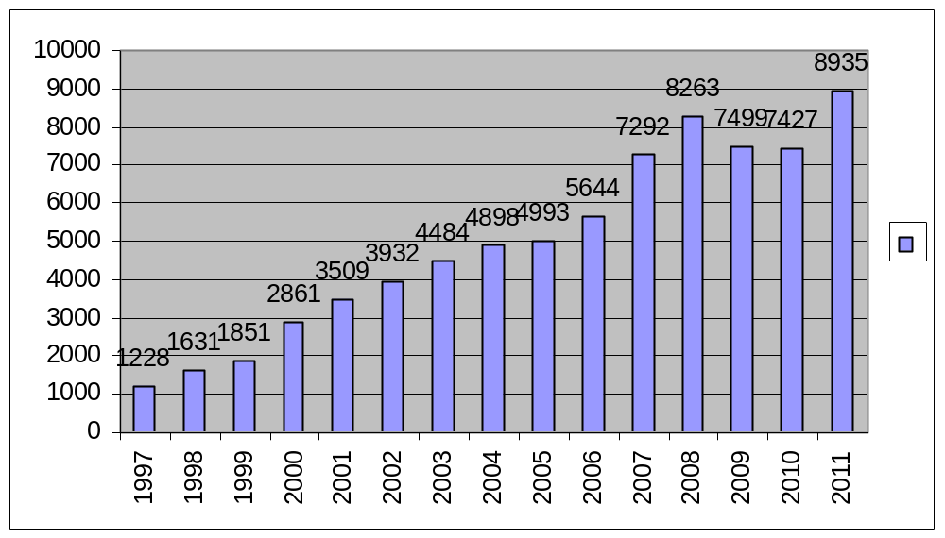
Upazila Health Complex
CHOWGACHA , JESSORE.
EOC Activities : 1997- 2011 (ANC First Visit)

Slide 10
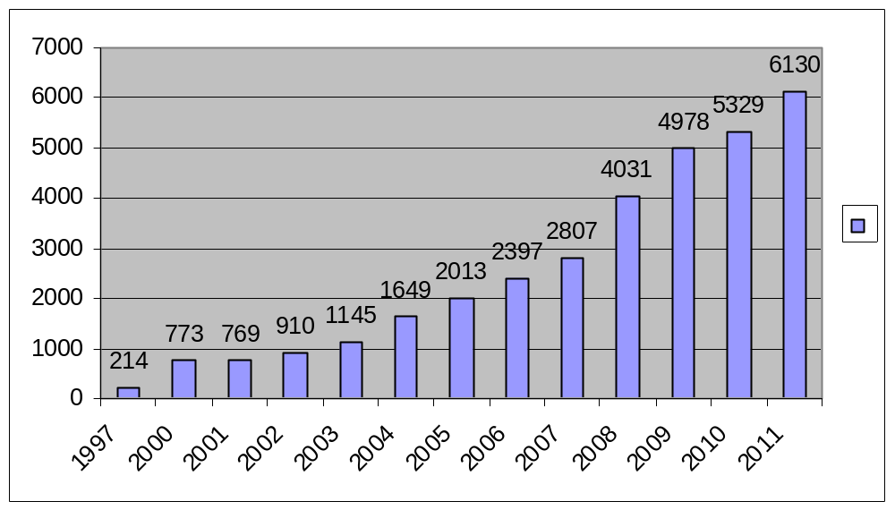
Upazila Health Complex
CHOWGACHA , JESSORE.
EOC Activities : 1997- 2011 (Admission in labour ward)

Slide 11
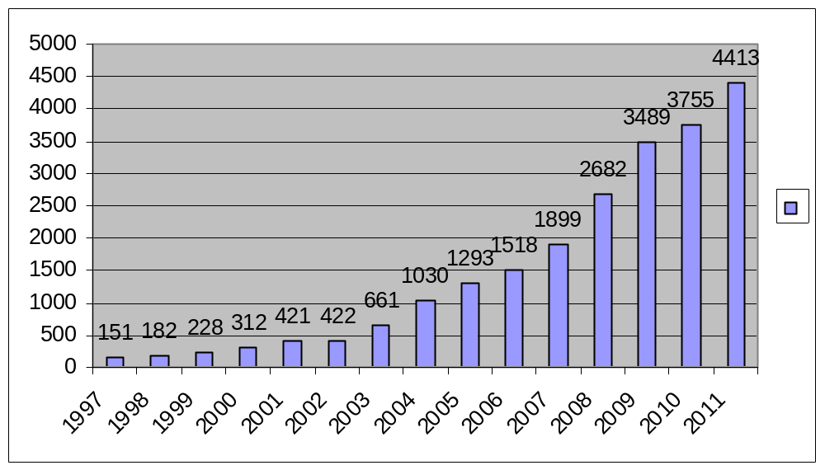
Upazila Health Complex
CHOWGACHA , JESSORE.
EOC Activities : 1997- 2011 (Hospital Delivery )

Slide 12
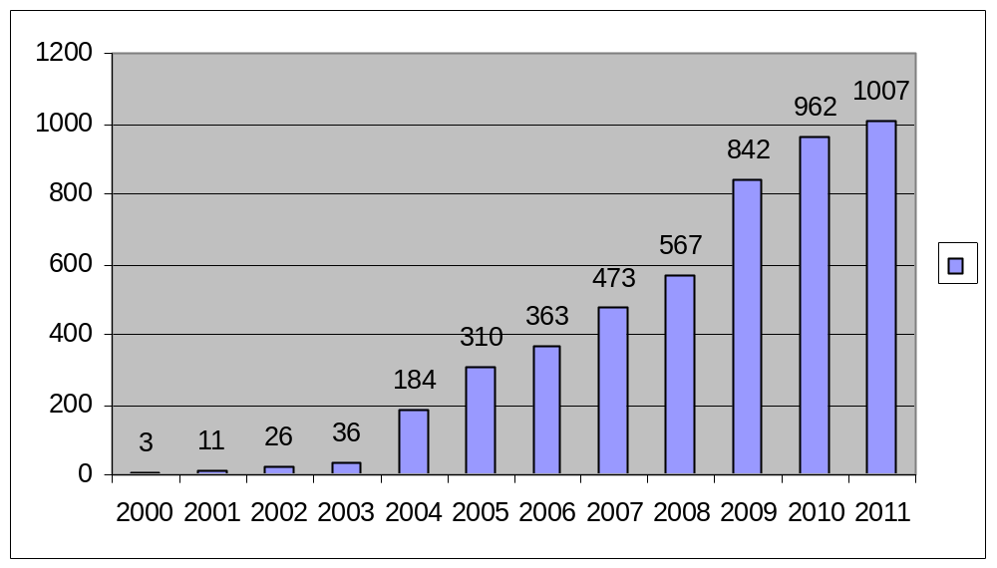
Upazila Health Complex
CHOWGACHA , JESSORE.
EOC Activities : 2000 - 2011 (Caesarian Section)

Slide 13
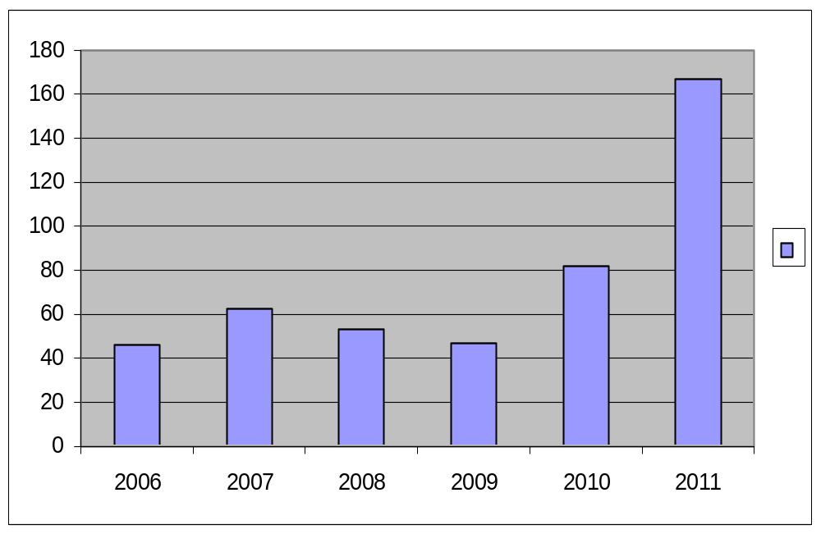
Upazila Health Complex
CHOWGACHA , JESSORE.
EOC Activities : 2006 - 2011 (Caesarian Tubectomy)
167
2011
82
63
53
46
47

Slide 14
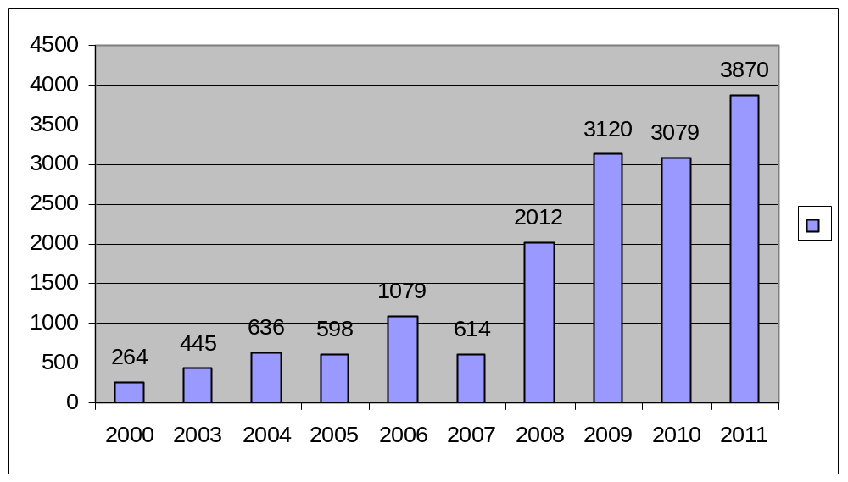
Upazila Health Complex
CHOWGACHA , JESSORE.
EOC Activities : 1997- 2011 (PNC )

Slide 15
Upazila Health Complex
CHOWGACHA , JESSORE.
Progress Of EOC Activities based on UN Process Indicators
SL No | Indicators | 2005 | 2007 | 2008 | 2009 | 2010 | 2011 | Target of UN Process
01 | Total Pregnancy | 5270 | 5489 | 5793 | 5595 | 5208 | 5264 | -
02 | Total Hospital delivery | 1293 | 1899 | 2682 | 3489 | 3755 | 4413 | -
03 | Total Caesarian section | 310 | 473 | 567 | 842 | 962 | 1007 | -
04 | Maternal death in health Complex. | 03 | 01 | 3 | 0 | 0 | 3 | -
05 | % of birth in health Complex. | 26.5% | 38.1% | 52.4% | 72% | 84.8 | 98.6 | >15%
06 | Met-need for EmOC | 92.1% | 107% | 175 % | 232% | 267% | 263% | 100%
07 | Caesarian section of all births | 6.3% | 9.7% | 11% | 17.3% | 21.7% | 22.5%* | 5-15%
08 | Case Fatality Rate | 0.44% | .13% | 0.20% | 0.0% | .0% | 0.38% | <1%
* Among the total delivery of Chowgacha Upazilla, the CS rate is 12.8% but CS 9.7% is
increased due to complicated delivery from outside this upazilla.

Slide 16
Upazila Health Complex
CHOWGACHA , JESSORE.
Comparative Data of Delivery of best performing EOC center of Khulna Division in 2011
SL No | Name of institute | NVD | Vacuum Del. | V. Breech | C. Section | Total
01. | Chowgacha UHC | 3346 | 34 | 26 | 1007 | 4413
02. | Ad-din Hospital Jessore. | 1124 | 0 | 0 | 1864 | 3492
03. | Khulna Medical College Hospital | 1581 | 58 | 18 | 1356 | 3013
04. | 250 bed Hospital, Jessore | 1327 | 2 | 25 | 1498 | 2852
05. | 250 bed Hospital, Khustia | 1728 | 0 | 34 | 915 | 2677
06. | Jhenidah Sador Hospital | 1914 | 0 | 33 | 430 | 2337
07. | Fatima Hospital Jessore. | 519 | 0 | 6 | 1061 | 1586

Slide 17
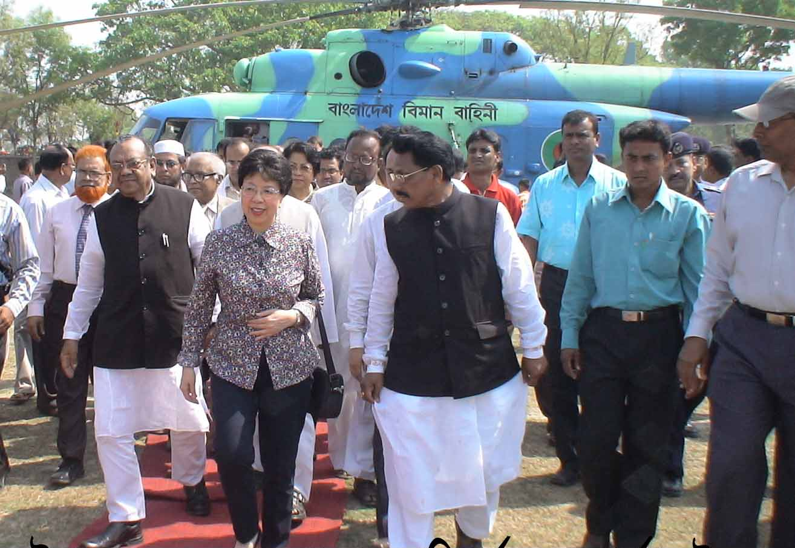
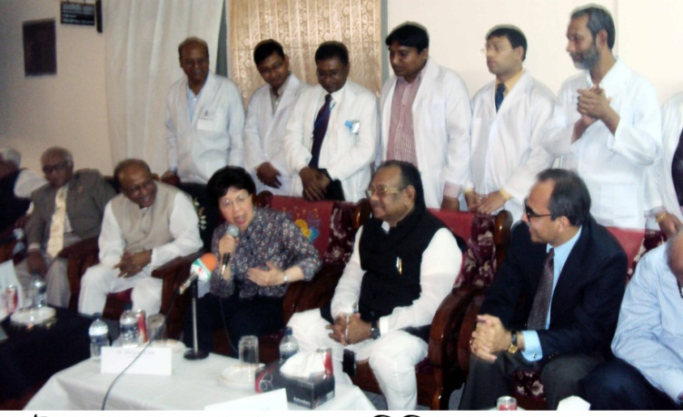
Upazila Health Complex
CHOWGACHA , JESSORE.
Dr. Margaret Chan, D.G. WHO visited Chowgacha
Health Complex Model on 8th March 2010.

Slide 18
JHENIDAH SADAR HOSPITAL Report-1998 to August 2012
Dr. Nasrin Sultana
Hospital Super
&
Dr. Md. Emdadul Haque
Senior Consultant (Obs & Gynae)
Sadar Hospital, Jhenaidah.

Slide 19
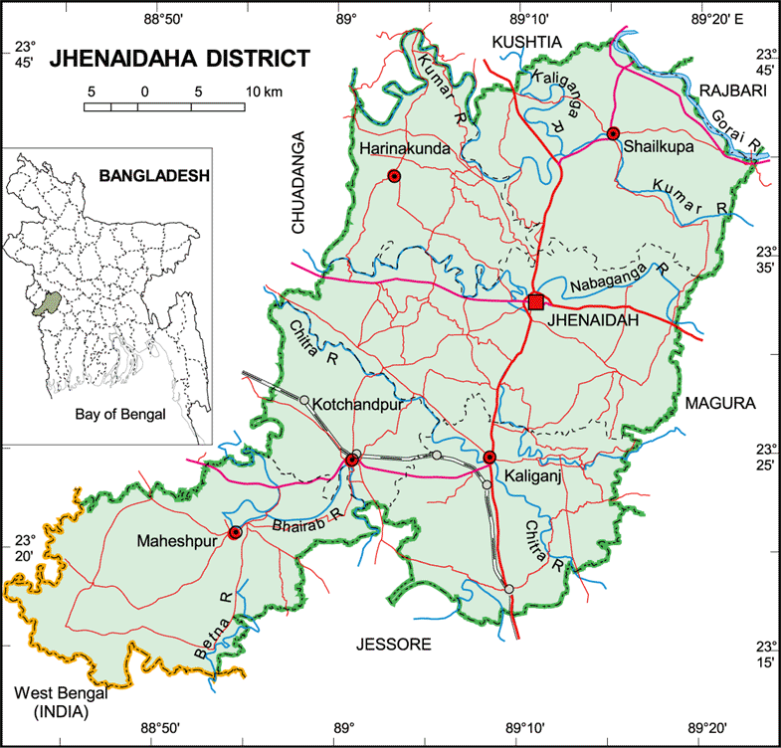

Slide 20
A District level Patient-Friendly Hospital with a Vision …
Maximum utilization of Govt.
resources with
honesty and sincerity
Integrated approach of
Administration, Community
Leaders & Health
Management
Providing Effective and
prompt services
through improved
management system
Show respect to the
patients
Develop as a model District
Hospital in Bangladesh

Slide 21
Health Profile of Jhenaidah District- 2011
Total Upazila : 06
Total Paurasava : 06
Total Union : 67
Total Village : 1271
Govt. Health Institution :
Sadar Hospital : 01
Total Health Complex : 05
Total H&FWC/ RD (57+13) : 70
Community Clinic : 167
NTC : 01
IHT : 01
MCWC : 01
MATS : 01
Sishu Hospital : 01
ORS Preparation Plant : 01
Non-Govt. Health Institution :
Diabetic Hospital : 01
Eye Hospital : 01
Non-Govt. Clinic (Redg.) : 114

Slide 22
Health Profile of Jhenaidah District- 2011
Total population : 1857149
Total Pregnant : 38074
Total Live birth : 36926
Total Under five children : 200769
As per National data
Total Death : 11142 (D.R 6.1/1000 pop)
Total Maternal Death : 72 (MMR 194/100000 LB)
Total Parental Death : 1903 (PNDR 50/1000 Del)
Total Neonatal Death : 1366 (NNDR 37/1000 LB)
Total Infant Death : 1920 (IMR 52/1000 LB)
Total Under five Death : 2400 (U5MR 65/1000 LB)

Slide 23
Human resources of Jhenaidah Sadar Hospital-2011
(100 Beded ( 50 Beded )
Post Post Vacant
a) Doctors 42 22 2
Super 01 0 0
Consultant (11+10) 21 10 2
MO 20 12 0
b) Nurse 38 42 2
Super 01 0 0
Supervisor 02 02 0
SSN/ JN (35+0) 35 (35+5) 40 2
c) 2nd & 3rd Class 30 20 3
Office Staff 08 04 0
MT +Pharma (6+3) 09 (3+3) 06 1
Others 13 10 0
d) 4th Class 40 24 0
Aya+Ward Boy (3+5) 08 0 0
MLSS+ Cleaner (5+5) 10 (10+7) 17 0
Guard 05 0 0
Cook 04 03 0
Others 17 04 0
Total Manpower 150 105 5
e) Non Govt Aya+ Cleaner+ Guard 38 0

Slide 24
Background History of Jhenaidah Sadar Hospital
Foundation stone of Jhenaidah Sadar Hospital was established in 1968 as Sub-Division Hospital in Eleven acre area at Hamdah. The hospital become functioning from December 1970.
- From February 1984 recognized as District Sadar Hospital.
- In 1994 upgrade to 100 Bedded Hospital without manpower & infrastructure.
- In June 2000 Spinal Anesthesia used in operation.
- In May 2005 infrastructure of 100 beded hospital completed.
- In September 2006 C.C.U infrastructure completed without manpower.
- In 2006 EOC ward become functioning.
- In 2007 Laparoscopic surgery used in Hospital.
- In February 2010 NTC become functioning by admission of 31 nurse student.
- In 2010 the Hospital is awarded for EOC Activities for its best performance in
Khulna Division among the District Hospital.
- In September 2012 Honorable Health & Family Welfare Minister visited Jhenaidah
Sadar Hospital and satisfied for hospital activities.

Slide 25
Sadar Hospital, Jhenidah
Health, populaton and Nutrition Targets for the SFYP -1
Sl | Indicators | Base value with year | FY 2015
 | Impact / Outcome
1. | Life Expectancy | 66.6 ( SVRS 2007) | 70
2. | Population Growth Rate | 1.40 ( SVRS 2007) | 1.3
3. | Maternal mortality Ratio (MMR ) per 100000 live births | 194 ( BMMS2010) | 143
4. | Neonatal Mortality Rate ( per 1000 live births) | 37 ( BDHS 2007 | 27
5. | Infant Mortality Rate ( per 1000 live births ) | 52 ( BDHS 2007) | 31
6. | Under 5 mortality Rate ( per 1000 live births) | 65( BDHS 2007) | 50
7. | Malaria mortality ( per 100000 population ) | 4.4 | 2.2
8. | Maintain low prevalence of HIV | <1% | <1%
9. | Prevalence of Night blindness among pregnant women | 2.90% | 1%
10. | Underweight of Under 5 children 16-59 months ) | 41%( BDHS 2007) | 33%
11. | Stunting of under 5 children (16-59 months) | 43%( BDHS 2007) | 25%
12. | Total fertility rate ( TFR) | 2.7( BDHS 2007) | 2.2

Slide 26
Sadar Hospital, Jhenidah
Health, populaton and Nutrition Targets for the SFYP -2
Sl | Indicators | Base value with year | FY 2015
 | Output
13. | Contaceptive prevalence Rate ( CRP ) | 55% ( BDHS 2007) | 74%
14. | Permanent & Long acting FP ( of CPR ) | 7.3% ( BDHS 2007) | 20%
15. | TB case detection rate | 73% (NTP 2008) | 75%
16. | TB cure rate from | 92% ( NTP 2008) | 95%
17. | Births attended by skilled health personnel | 26.5% ( UESD 2010) | 50%
18. | Facility level delivery | 15% ( BDHS 2007) | 40%
19. | ANC coverage ( 4 visits ) | 20.6% ( BDHS 2007) | 50%
20. | PNC coverage ( Mother ) | 21.3( BDHS 2007) | 50%
21. | PNC coverage ( children ) | 21.9% ( BDHS 2007) | 50%
22. | Met need for EOC services | 22.43% ( BDHS 2007) | 80%
23. | TT coverage ( Children Protected at birth from tetanus ) | 93%(CES 2008) | 95%
24. | Valid coverage of full immunized children | 75.2% (CES 2008) | 90%
25 | Immunization of 1 year old children against Measles | 83%(CES.2008) | 90%
26 | VAC coverage ( 6m -6y) | 98%-100% | 98%-100%
27 | Postnatal VAC supplementation | 29% | 80%
28 | Severe anemia ( Children ) | 64% | 50%
29 | Severe anemia ( Pregnant women ) | 46% | 40%
30 | Exclusive breast feeding of children ( less than 6 months) | 42% | 80%

Slide 27
Sadar Hospital, Jhenidah
Emergency & Out door Service 1998 to August 2012
Sl No | Year | Emergency Patients | Out door Service
01 | 1998 | 16733 | 65062
02 | 2009 | 23116 | 136464
03 | 2010 | 25868 | 123764
04 | 2011 | 28855 | 141999
05 | 2012 August | 19979 | 91469

Slide 28
Sadar Hospital, Jhenidah
Indoor Service 1998 to August 2012
Sl No | Year | indoor Service | No of Bed | Bed occupancy rate
01 | 1998 | 12973 | 100 | 126%
02 | 2009 | 19623 | 100 | 137%
03 | 2010 | 20384 | 100 | 136%
04 | 2011 | 22435 | 100 | 146%
05 | 2012 August | 15044 | 100 | 132%

Slide 29
Sadar Hospital, Jhenidah
EOC Service 1998 to August 2012
Sl No | Year | ANC Services | Admitted Patient | Complications | Type of Delivery |  |  |  | PNC | Maternal Death
 |  |  |  |  | NVD | ASST DEL | CS | Total
01 | 1998 | 257 | 1364 | 542 | 951 | - | 155 | 1106 | - | 18
02 | 2009 | 434 | 3264 | 1374 | 1673 | 42 | 539 | 2254 | 2302 | 05
03 | 2010 | 1099 | 3514 | 1317 | 1778 | 32 | 546 | 2356 | 2256 | 4
04 | 2011 | 1354 | 3906 | 1191 | 1912 | 33 | 430 | 2375 | 2140 | 1
05 | 2012 August | 841 | 2517 | 966 | 1109 | 25 | 320 | 1454 | 1333 | 2

Slide 30
Sadar Hospital, Jhenidah
Development in EOC Service in Jhenidah.
Introduce Labour Admission Register, Labour Ward Admission Form, Separate Discharge Form.
All EOC Related Patient kept in a ward.
Starting of ANC & PNC corner and Arrange a Room for Medical Officer.
NO. of EOC Bed increase from 10 to 21 though on EOC bed only 5.
Improve EOC Operation Theater.
Shifting of Labour room & arrange pre-labour room with three beds & maintenance of privacy.
Moral based environment with 7 (seven) workers supported by community donors.
Make a breast feeding corner & Provision of Vitamin A distribution for PNC Mother.
Starting of Health education system.
Set up of dropler machine & Ventouse Machince.
EOC Operation activities extended from 8 A.M. to 2 P.M to 8 P.M.
Ensuring Rational use of drugs in EOC ward.
Provision of Mobile Phone in EOC ward no. 01742732116.
Improvement of Eclumpsia room.
Provision of Emergency kit boxes such as PPH kit, Eclumpsia kit.
Shoe-free environment for infection control.
The center is used as a effective training center for SBA, Nursing student, Mid-wifiry.

Slide 31
Sadar Hospital, Jhenidah
Operation Service 1998 to August 2012
Sl No | Year | Major | Minor | Total
01 | * 1998 | - | - | 1089
02 | 2009 | 891 | 3099 | 3980
03 | 2010 | 842 | 3276 | 4127
04 | 2011 | 780 | 4857 | 5629
05 | 2012 August | 548 | 3911 | 4459
* There was no Anesthesiologist in 1998

Slide 32
Sadar Hospital, Jhenidah
Blood Transfusion Service 1998 to August 2012
Sl No | Year | No. of Bag
01 | 1998 | 661
02 | 2009 | 2186
03 | 2010 | 1985
04 | 2011 | 1423
05 | 2012 August | 869

Slide 33
Sadar Hospital, Jhenidah
Medico Legal Case 1998 to August 2012
Sl No | Year | Physical Assault | Post Mortem | Suicidal
 |  |  |  | Poisoning | Hanging | Total
01 | 1998 | 1379 | 487 | - | - | 370
02 | 2009 | 1650 | 142 | 683 | 45 | 728
03 | 2010 | 1527 | 115 | 747 | 66 | 813
04 | 2011 | 1721 | 110 | 873 | 58 | 931
05 | 2012 August | 1071 | 80 | 513 | 39 | 552

Slide 34
Sadar Hospital, Jhenidah
No. of Patient’s Death 1998 to August 2012
Sl No | Year | No. of Death
01 | 1998 | 541
02 | 2009 | 446
03 | 2010 | 247
04 | 2011 | 403
05 | 2012 August | 186

Slide 35
Problems of Sadar Hospital-1
100 Beded Hospital running with 50 beded manpower since 1994.
Hospital security is hampered due to broken boundary wall
There are 9 units in hospital (wards 06, OT, Out door, Emergency) need cleaners about 36 but there are only 7 cleaners.
There is no post of Aya, Ward boy, Security guard in the Hospital.
There is no post of indoor medical officer so hamper indoor service & night rounds.
One (01) anesthesiologist working for surgery, gynae, Orthopedics, ENT, Eye, 24 hours EOC & emergency service.
There is no effective waste management system.
Condemnation board is not working regularly due to administrative problems.
Many of the instruments and equipments are not functioning due to lack of bio-technologist & funds for repair.
There is no target for indoor-outdoor patient & huge number of indoor & out door patient creates a heavy loads for services providers .
MIS system is weak and there is no hospital action plan.
No client satisfaction survey system.
The number of nurses is very few.
Hospital health management committee & monthly co-ordination committee meeting is not perform regularly.
Female privacy is not properly maintained.
Insufficient in toilets & safe drinking water supply.
Influential person influence on tenders of drugs, free cabin & paying ward.
Auditing & accounting system is not corruption free.
Consultants & MOs are also the teacher of NTC, MATS etc. which affect hospital services.
Three doctors are illegally suspended.

Slide 36
Problems of Sadar Hospital-2
There is no visitor control system .
EPI, ORT corner, DOTS corner, VIA centre are running with least or no defined health personnel.
Health education systems is very poor .
There is no pediatrician in this Hospital.
There are 5 beds in EOC word, which is insufficient for 40000 pregnant mother per year in Jhenidah District .
There is no intercom system .
There is no IMCI corner for under 5 children .
Non health Issues get less importance.
Scarcity of blood in emergency need.
There is no adolescence health corner.

Slide 37
Sadar Hospital, Jhenidah
Community Support System in Sadar Hospital
Nine man power (2000 Tk per month per person) is supported by Dr. Abdur Rahman (Anesthesiologist) , Dr. Nasrin Sultana (Civil Surgeon ) Dr. Md. Emdad ( Senior Consultant , Gynae & Obs) , Mr. Moniruzzaman ( Shimul) Industrialist of Chowgacha & Social Welfare Deptt. of Drug International Pharmaceutical .
Jhenidah Powrshova play a major role in cleanness of the outer environment of the Hospital
Voluntary blood donors donates blood regularly .
UP Chairman Mr Farid repears 3 benches for seating of EOC outdoor patient.
EMOs of the Hospital repaired their broken windows by sell donation
Some of the Pharmaceuticals helps in forms and discharge certificate and seating arrangement
Mr. Shorahb Hossain (Sabu), Mr. Johir Uddin helps in butification and wll writing of EOC ward.

Slide 38

Thank you

